Slide 1
Pathological Demand Avoidance Syndrome
Bobbi Cook
Senior Behaviour Therapist
Copyright © Bobbi Cook Behaviour Management 2022
All Rights Reserved

Slide 2
Professional Learning!
Are you a professional attending tonight's webinar?
Would you like a certificate of attendance for your professional body?
Please email your answers to reception@bcbm.com.au
What are 3 main differences between ODD and PDAS?
Name and give an example of 3 different types of demands
What are 3 underlying factors that contribute to the challenges for young people with PDAS?

Slide 3
What is PDAS?
Resisting and avoiding the ordinary demands of life
Using social strategies as part of the avoidance
Appearing sociable on the surface but lacks a depth of understanding
Excessive mood swings and impulsivity
Being comfortable in role play and pretence, sometimes to an extreme extent and the lines between reality and pretence can become blurred
‘Obsessive’ behaviour that is often directed at others

Slide 4
Other PDAS Characteristics
Low self esteem
Use of threats of violence and extreme language in response to pressure
Violence towards self, others or property
Communication delays
Trauma
Executive functioning and planning difficulties

Slide 5
Asking the same question over and over
Extreme anxiety
ADHD
Oppositional Defiance Avoidance
Autism
Pathological Demand Avoidance

Slide 6
Asking the same question over and over
What is Task and Demand Avoidance?
The act of putting more energy into avoiding doing a task than it actually takes to do the task
Banging or bumping self and having an over the top response
Going to the loo for 1000000000 minutes
Starting an argument

Slide 7
Demands
Direct
Indirect
Implied
A consequence
Self imposed

Slide 8
What is a demand?
Indirect demands: from body or environment | Direct demands
Bodily functions: Eating Toileting Sleep | Requests
If we drop it pick it up | Instructions
Manners and social norms and morays | Directions
Work | Suggestions
Complete a task | Recipes
Say thankyou/ apologise/greetings
Praise
Success
Birthday or other celebration

Slide 9
You don’t know what you don’t know
Ability
versus
Capacity
Confusing for parents and teachers
Initially unpredictable
Consider obvious antecedents
Not intentional/ not malicious
Understanding reduces your stress

Slide 10
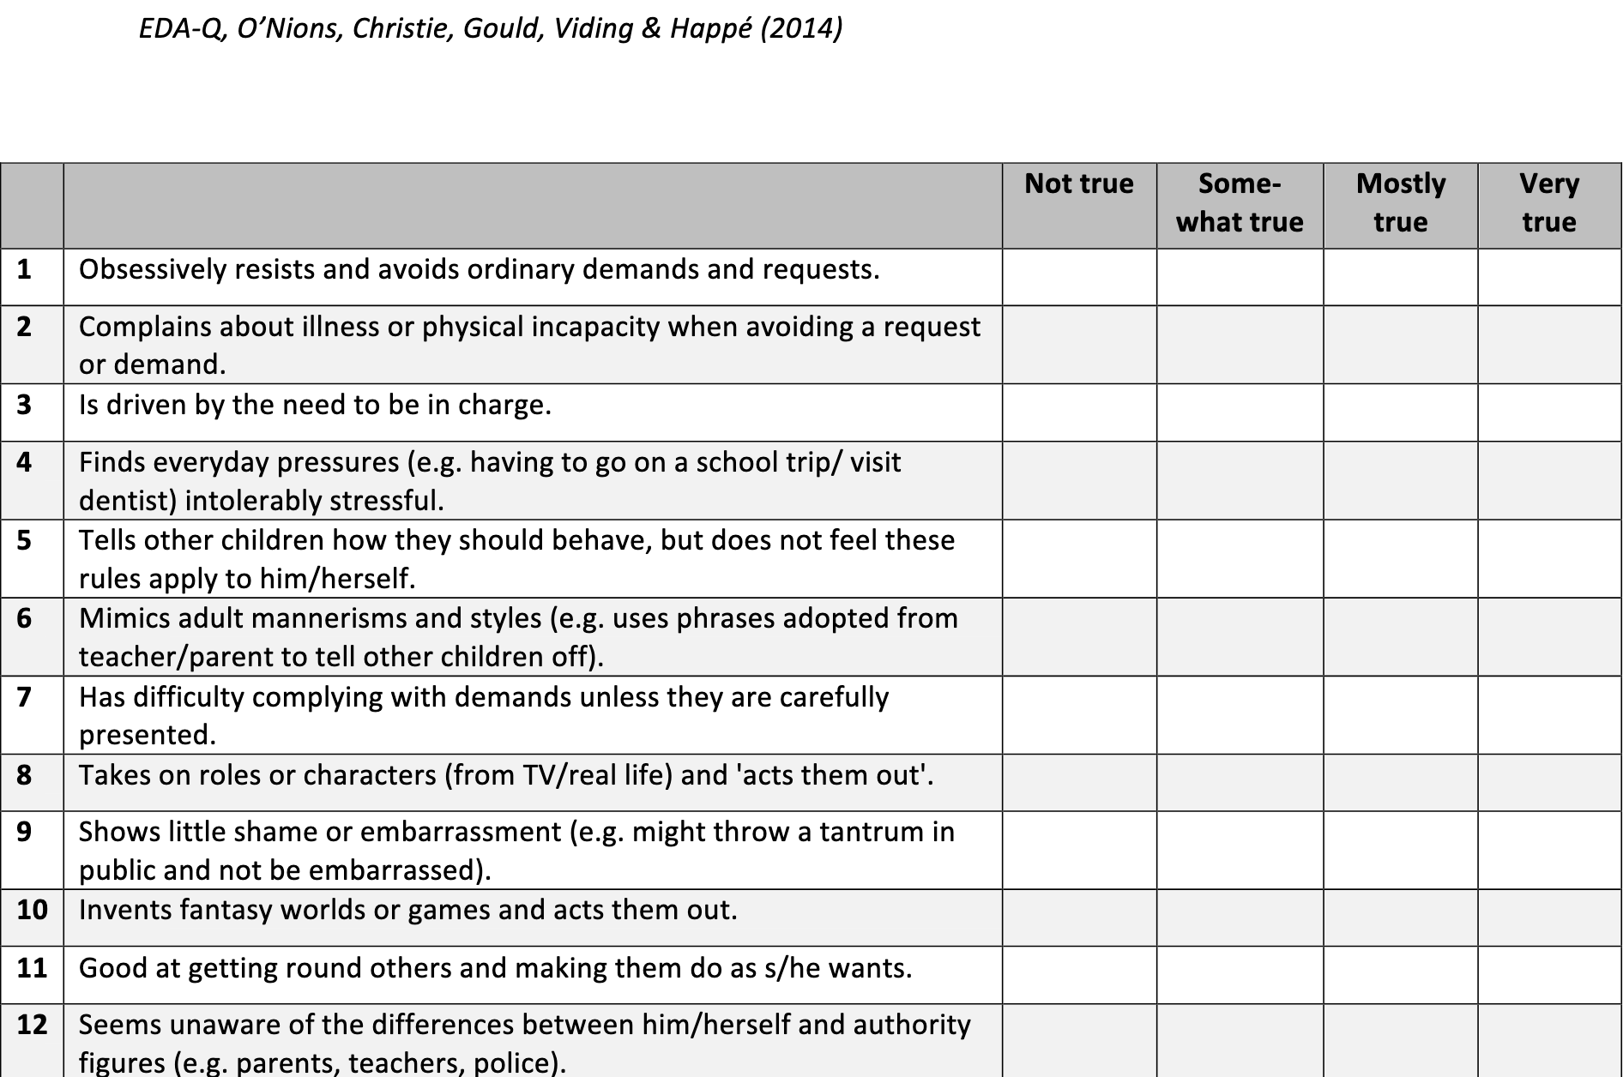
Extreme demand avoidance questionnaire

Slide 11
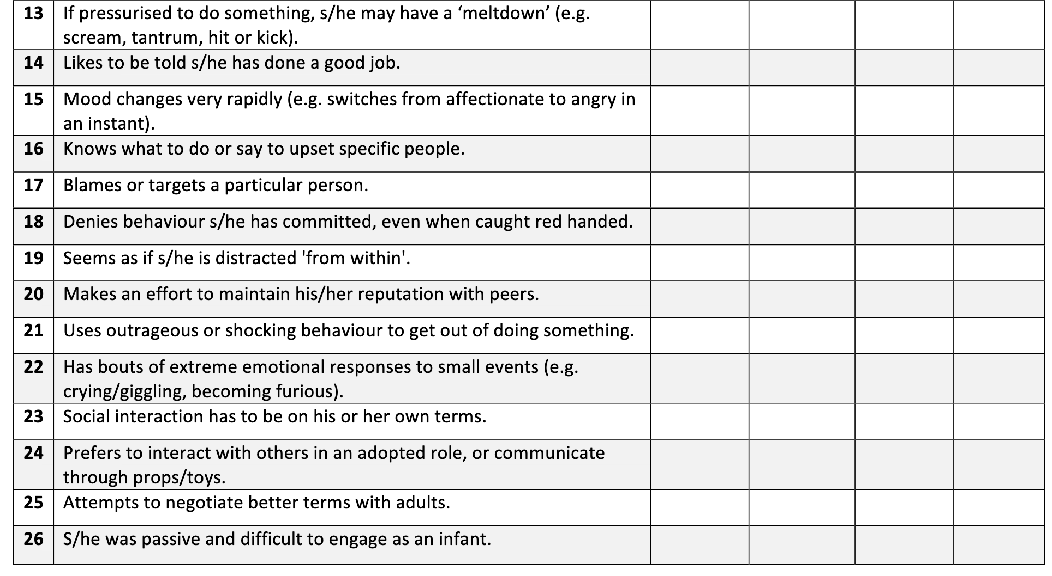
Extreme demand avoidance questionnaire

Slide 12
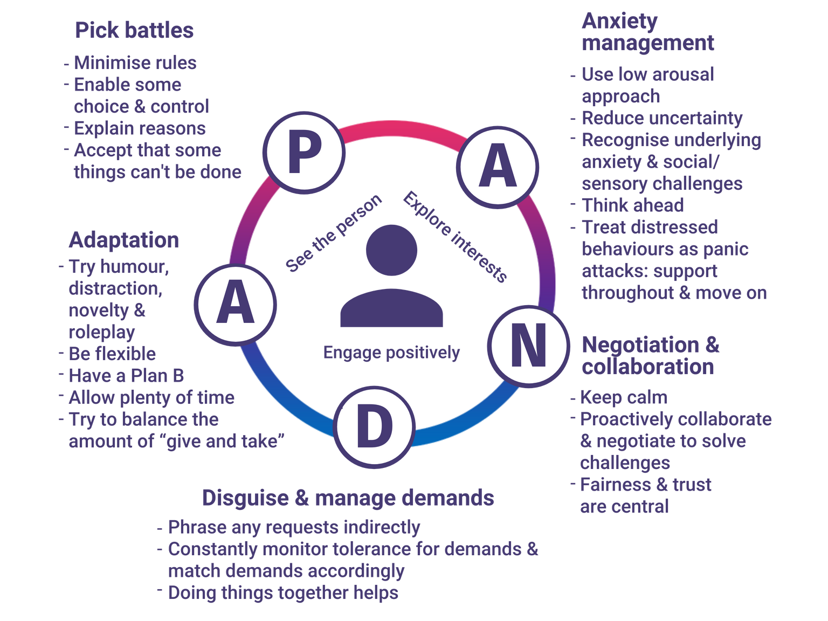
Source PDA UK

Slide 13
Adjusting your mindset
Look beyond surface behaviours – tip of the iceberg
Re-balance your relationship
Keep calm
Focus on the long-term objective
Be flexible
See the positives
Support and care for yourself

Slide 14
Support of the underlying difficulties
Difficulties in processing language and communication
Difficulties in social interactions
Confusion about emotions
Intolerance of uncertainty
Sensory overload

Slide 15
Support with the underlying anxiety
Become attuned to early warning signs and help other family members to ‘get it’
Recognise how anxiety can present - avoidance, anger, shouting, collapse, crying
Laughing
Not talking, boredom, tics, obsessing, skin picking, withdrawing, masking and lashing out
Work together to find solutions and ideas that you can experiment with

Slide 16
Distressed feelings
Distressed feelings occur when we become overwhelmed and capacity to cope has been busted. It is like a panic attack, and we go to old responses. We usually only lose it when we don’t know what else to do or we have reached our limit. ( this is true for all concerned child, young person, siblings, parents, etc.)
Manage your distress, reduce stimuli, give space, be aware of safety, and potential hazards
Try to move through incidents as quickly as possible
Provide reassurance and recovery time with a regulating activity
Remind yourself regularly it is not personal

Slide 17
MAP
Mirroring
Asking
Propping up

Slide 18
Mirroring scripts
I’m wondering if you are feeling frustrated/disappointed/annoyed/discouraged.
It makes sense that you’re feeling frustrated/disappointed/annoyed/discouraged. This is a tough situation.
It seems like you’re having one of those “I can’t do it” thoughts. (Alternative: It seems like you’re having one of those “I’m not good enough” thoughts.)
I could be wrong, but it seems like you could be feeling frustrated/disappointed/annoyed/discouraged right now.
You look like you’re having a hard time <state their goal>, and and I wonder if you are feeling frustrated/disappointed/annoyed/discouraged.
It sounds like you had an idea in your head about how your project/art/story should go, and it’s not turning out how you hoped. I’m wondering if you might be feeling frustrated/disappointed/annoyed/discouraged?
Notes:
“Research shows that merely assigning a name or label to what we feel literally calms down the activity of the emotional circuitry in the right hemisphere…Sometimes parents avoid talking about upsetting experiences, thinking that doing so will reinforce their children’s pain or make things worse. Actually, telling the story is often exactly what children need, both to make sense of the event and to move on to a place where they can feel better about what happened…The drive to understand why things happen to us is so strong that the brain will continue to try making sense of an experience until it succeeds. As parents, we can help this process along through storytelling.”
Dr. Daniel Siegel and Dr. Tina Payne Bryson, The Whole-Brain Child⁴
For example, you might say one of the mirroring statements below and use your tone of voice⁵, facial expressions⁶, and body language⁷ to mirror how your child is feeling and to align with your own words. Much of human communication is non-verbal, so by aligning your words and the non-verbal cues you’re sending, you’ll communicate in a meaningful way that you really do get how your child is feeling.

Slide 19
ASK
“Too often adults tell children what happened or what is wrong, what caused it to happen, how the child should feel about it, what the child should learn from it, and what the child should do about it.
It is much more respectful, encouraging, and inviting of skill development when we ask what happened or what is wrong, what the child thinks caused it, how she feels about it, what she has learned, what ideas she has to solve the problem, or how she can use in the future what she has learned.
This is the true meaning of education, which comes from the Latin word educare, which means ‘to draw forth.’ Too often adults try to stuff in instead of draw forth, and then wonder why children don’t learn.”
Dr. Jane Nelsen, Positive Discipline¹⁰

Slide 20
Ask
Can you tell me about/show me what you’re trying to do?
Can you tell me about/show me the hard part?
What did you learn from this so far?
Can you think of a better way?
What ideas do you have for how to fix this?
What’s one thing you could do next so that you can <state their goal>?
I’m hearing that <state their goal> is important to you. What could you do that would get you closer to that?
If you could wave your magic wand to fix this, what’s the first thing you’d have your magic wand do?
Notes:
Why this step is important: Nurturing your child’s problem-solving skills is one of the greatest gifts you can give them. Kids who lack problem-solving skills may be at a higher risk for depression and suicide.¹¹ On the other hand, when you teach children problem-solving skills, research shows that kids are less likely to have behavioral issues, plus they get better at controlling their own impulsive behavior.¹² ¹³

Slide 21
Prop up
Words of encouragement – do you remember last week when Bobbi didn’t want to play with you, and you could problem solve it and find someone else to play with. I wonder how I can help you can do that again today.
Programs – ASC, holiday programs community access, social skills groups, therapies
Tools - fidget tools
Differentiation, modification and adaptation

Slide 22
Tasks Listed From Easiest to Most Difficult
Understanding “wanting”: The first step is the realization that others have diverse desires, and to get what they want, people act in different ways.
Understanding “thinking”: The second step is the understanding that others also have diverse beliefs about the same thing, and that people’s actions are based on what they think is going to happen.
Understanding that “seeing leads to knowing”: The third stage is recognizing that others have different knowledge access, and if someone hasn’t seen something, they will need extra information to understand.
Understanding “false-beliefs”: The fourth stage is being aware of the fact that others may have false-beliefs that differ from reality.
Understanding “hidden feelings”: The final stage is being aware that other people can hide their emotions and can feel a different emotion from the one they display.

Slide 23
Some potential things to say to others to help them understand
AVOIDANCE
Avoidance isn’t a choice. PDA means I can’t help not complying with your requests/instructions or even my own wishes. Everyday tasks can be a real struggle for me. Not feeling in control creates extreme anxiety, though it may not look like it (I may ignore or distract you or seem angry). If pushed it can trigger a sudden freeze, flight, fight response.
Think of PDA as ‘permanent demand anxiety’
Make requests and communication indirect
Doing things together helps
Monitor important areas to avoid health problems (e.g. dehydration)

Slide 24
MOOD & DISTRESSED BEHAVIOURS
PDA can lead me to feel excited & energetic or lethargic & low and these changes can occur in quick succession.
Distressed behaviours (meltdowns, shutdowns, taking flight, physical/verbal aggression or self-injury)
can occur quickly when my capacity to cope has been exceeded and I feel overwhelmed –
I may not always know the trigger or be able to communicate whilst in crisis or remember what I’ve done/said. I may feel guilty later.
Expect mood fluctuations
Constantly monitor tolerance for demand & match demands accordingly
Treat distressed behaviours as panic attacks
Keep voice calm & body language submissive
Support me through distressed behaviours (I may not be able to process language or tolerate touch at this time)
Move on quickly after distressed behaviours (provide reassurance and recovery time)

Slide 25
ROUTINES & PLANNING
Some level of routine is helpful, but within it I need some flexibility and a sense of control.
Any changes to my environment or ways of working need forewarning - some negotiation of the details can help acceptance.
Accept that some things can’t be done
Provide choices over how things are done
Always think ahead: be proactive and head off problems before they occur
Be flexible with time and approach

Slide 26
SENSORY DIFFICULTIES
I may have some sensory processing difficulties – sensitivity to light, touch, textures,
smells, foods - and sensory integration difficulties around movement, balance or
understanding my body’s messages. These can lead to me feeling very unregulated if not addressed daily.
Be aware of how my sensory difficulties may impact my behaviour
Assess my sensory needs if this hasn’t already been done
Find ways for my sensory diet to be implemented in a PDA friendly way

Slide 27
ACTIVITIES & INTERESTS
If you engage with me in my special interests, I will begin to like and trust you and
there will be more chance of success. If I can trust you to keep me safe, we may be able to do more activities.
Ask what I like to do, and genuinely engage with me
Research in detail what’s available - make a short list we can discuss
Give me some, but not lots, of notice before any trips or activities
The trip/activity will become a demand, so be flexible. Try again another day if it doesn’t work out

Slide 28
Remember:
Everyone is doing the best they can do in the moment and that includes you!

Slide 29
Question Time
5 Shaftesbury Ave
Winter Valley VIC 3358
(03) 5309 0495
reception@bcbm.com.au
www.bcbm.com.au
www.facebook.com/bobbicookbm
Certificates may be requested by contacting reception@bcbm.com.au

